Slide 1

UNITED INTER NATIONAL UNIVERSITY
Project Presentation
Sub: Structured Programming Language Laboratory (CSI 122)

Slide 2
Member Profile
Foysal ahamed (ID:021091002)
Md.Suaib islam (ID:021091115)
Sanjid chowdhury (ID:021091144)
Department Of EEE

Slide 3
WELCOME TO OUR PRESENTATION

Slide 4
Title E-Ticketing For Bangladesh Railway

Slide 5
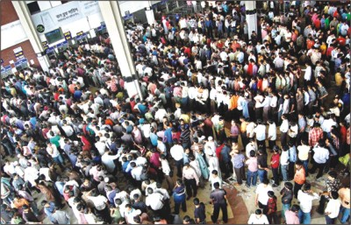
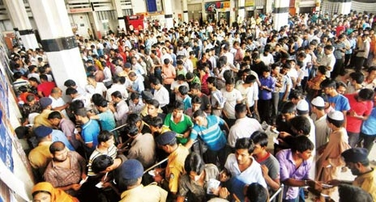
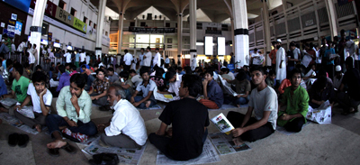
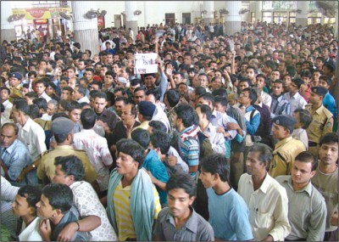
Why This attempt?

Slide 6
Our purpose:
Seat-reservation for passengers.
To inform passengers about their train.
To smooth the ticketing system.
To save time for collecting ticket.
To overcome collision for collecting ticket.
To prevent from ticket blacking.

Slide 7
Prerequisite for Passenger:
Knowledge about ATM operation.
A bank account.
A debit/credit/master or visa card.

Slide 8
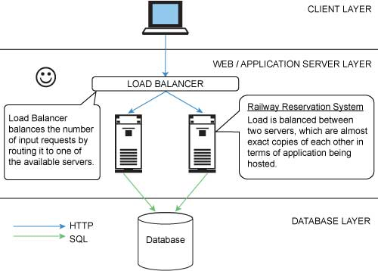
How It Works:

Slide 9
Passenger
Administrator
Start
Check for reservation
Reserve Ticket
Cancel Ticket
No
Yes
Inform passenger
View Details
Print Ticket
Reserve seat
Stop

Slide 10
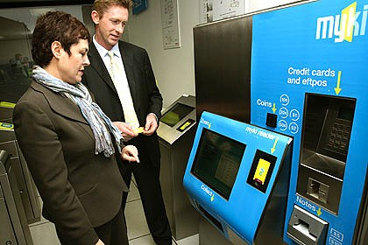
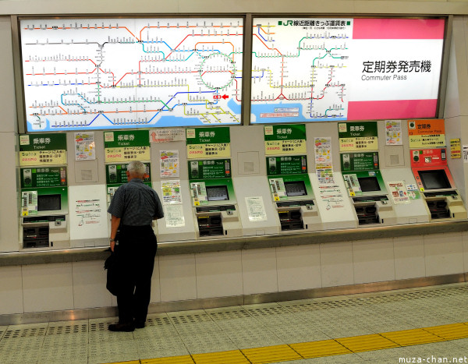
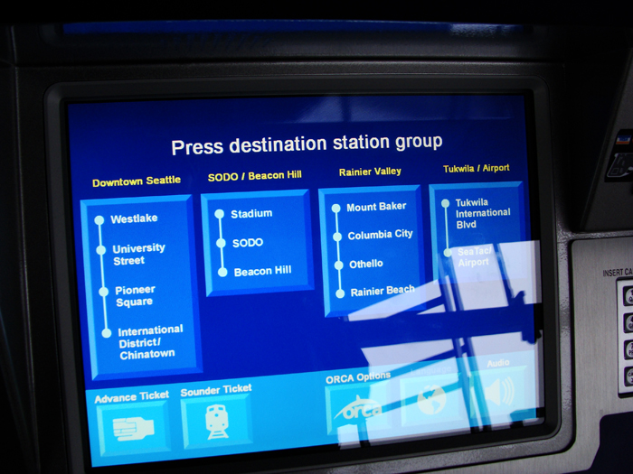
Our dream

Slide 11
Project Demonstration.
Source: I:\\Project\Debug\Final.exe

Slide 12
AT THE END

Slide 13


